Slide 1
Analysis of NYPD Complaint Data Using Machine Learning Techniques
INFO 5810

Slide 2
Introduction
From the analysis of New York Police Department, the complaint records are used to make new inquiries to a focus in patrolling to areas that consistently have slightly elevated rates depending on time frames, Boroughs and Location axes of the map. Being the most visited city by tourists in America and residents, over 95% of the people travel to work daily. Hence, it is a lively area with high crime rates essential to monitor in order to maintain order in New York city’s public places.

Slide 3

Problems to Solve
The following information pertains to New York region recording of crime complaints data. The problem may be stated as how this data may be employed to improve location prediction of crimes according to complaints.

Slide 4
Dataset
NYPD Crime complaint records

Slide 5
Data Explanation
In this dataset, we have unique complaint number and detail record of the data and time of incident. These categorizes into crime codes by KY_CD and PD_CD with OFNS_DESC and PD_DESC and the status of the complaint with law category and location latitude and longitudes. Raw records of data are found as below are 361740 records and 24 columns.

Slide 6
Data Preparation
This steps comes after deleting all the columns where count was above the - 50% missing values and all the rows that contain missing value in their respective cells in order to reduce on the level of error. Furthermore, other types of data columns such as the created date and time of the appearance of each complaint listing were also excluded as they are redundant.

Slide 7
Exploratory Data Analysis
Bar chart
Pie Chart
Stacked bar chart
Complaints based on Borough Names
Offensive description
Outcome of the law Category

Slide 8
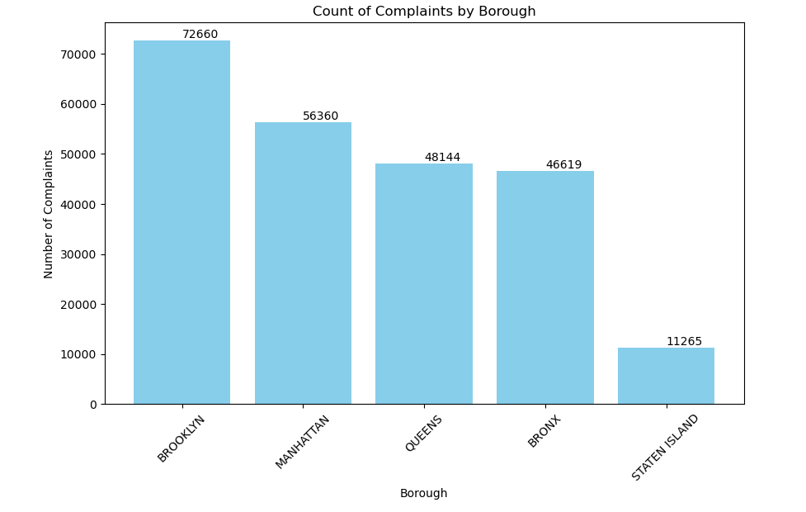
Plots

Slide 9
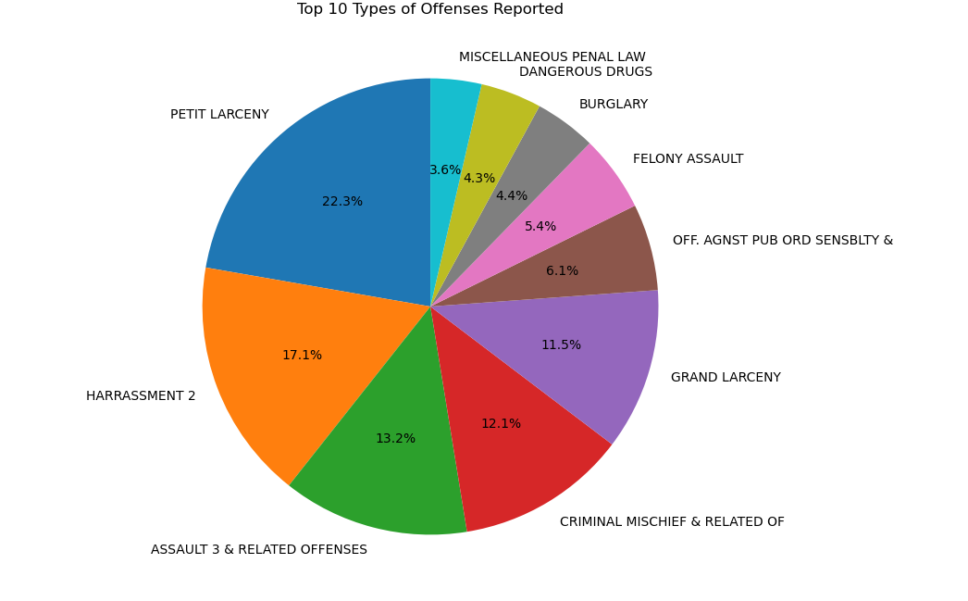
Plots

Slide 10
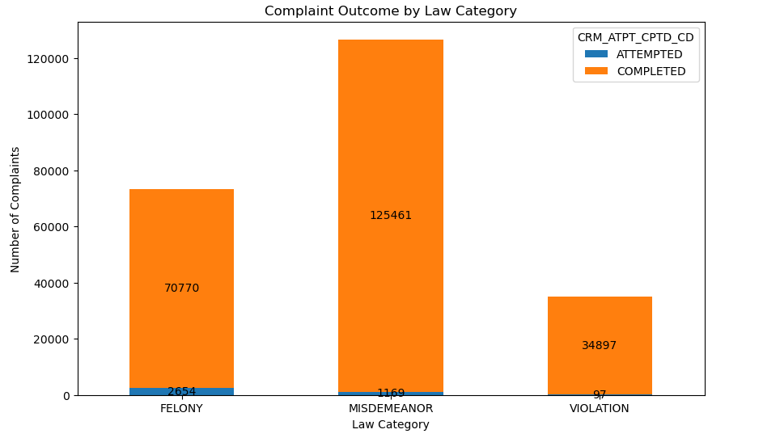
Plots

Slide 11

Data validation
In our data we have many columns which could possibly be categorized. Thus, for the data columns we have used label encoding techniques. We have implemented K fold cross validation in the code since cross validation has shown better results on splits of the training and testing data than models based on a random splits.

Slide 12
Algorithms Used
Logistic regression
Random forest classiification
Random forect regression

Slide 13
Algorithm Comparison
After using all the models, we are finalizing the model by the score produced by each model.

Slide 14

Model Prediction
We are calculating the scores for each model taken in the process

Slide 15
Thank You

